Slide 1
Chapter 4
Trees
Sets
Maps
Oct 24, 2011 | CECS 302. Instructor: I Imam

Slide 2
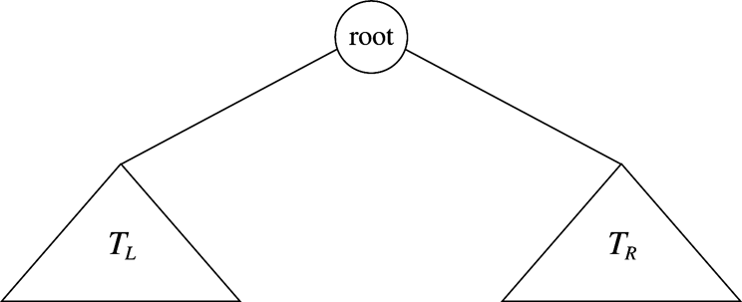
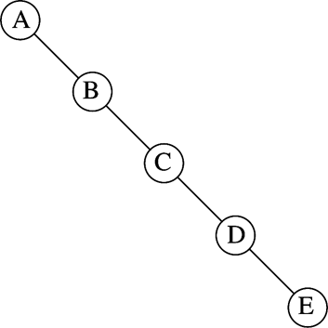
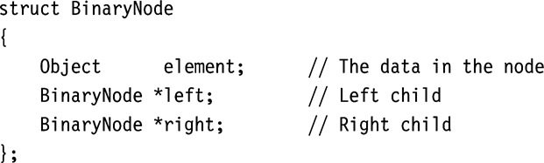
Binary Trees
In binary trees no node can have more than two children.
In pre-order we traverse the tree in the root, left, then right order.
In post-order we traverse the tree in the left, right, root order
In in-order we traverse the tree in the left, root, right order
Maximum depth can be n-1
Oct 24, 2011 | CECS 302. Instructor: I Imam

Slide 3
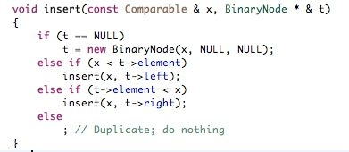
Methods for Managing Binary trees: insert
insert(x,t); // insert element x in tree t (t is the root):
If t is null then create a new t
if t is not null then iterate starting with the root t
if x < current element t then insert t in the left branch
if x > current element t then insert t in the right branch
if x = current element t then stop (we have duplicate item)
Oct 24, 2011 | CECS 302. Instructor: I Imam

Slide 4
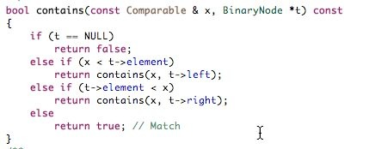
Methods for Managing Binary trees: contains
contains(x, t); // Does tree t contain element x?
If t is empty then return false
if x is found at current t then return true
if x not found at t then
if x < t then contains(x, left branch);
if x > t then contains(x, right branch);
Oct 24, 2011 | CECS 302. Instructor: I Imam

Slide 5
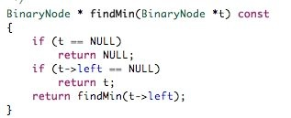
Methods for Managing Binary trees: findMin
findMin(t); // Find minimum element of tree t
If t is empty then return null
if "is there a left" returns null then return t (we are at the minimum)
else findMin(left branch)
For findMax(t) replace “left” with “right”
Oct 24, 2011 | CECS 302. Instructor: I Imam

Slide 6
Methods for Managing Binary trees: remove
remove(x,t); // We are to remove x from tree t
The difficulty of the remove method is in adjusting the tree after the node is deleted. To do this we follow the following steps:
If x is a leaf remove x and stop
If the node x has one child the we adjust the parent of x to point to the child of x and then remove x
If x has two children then we point the parent of x to the node that correspond to the minimum element in the right brach
Oct 24, 2011 | CECS 302. Instructor: I Imam

Slide 7
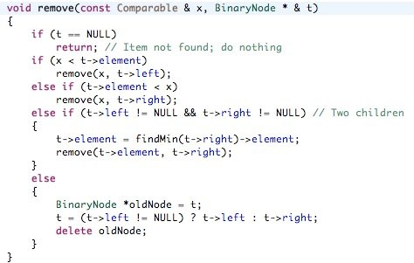
Methods for Managing Binary trees: remove
For the full implementation of binary trees see the code of the project: “01_BinarySearchTrees” in the chapter 4 source code
Oct 24, 2011 | CECS 302. Instructor: I Imam

Slide 8
Creating a Binary Tree
This example shows the stages of creating a binary search tree of the sequence of numbers:
11, 12, 6, 8, 7, 9, 2, 4, 10, 5, 14, 13
For details see “BinarySearchTreeExamples.pdf”
Oct 24, 2011 | CECS 302. Instructor: I Imam

Slide 9
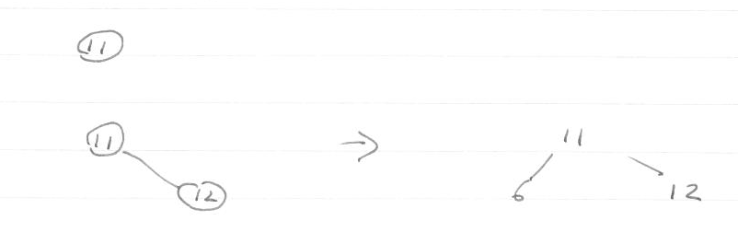
Creating a Binary Tree
This example shows the stages of creating a binary search tree of the sequence of numbers:
11, 12, 6, 8, 7, 9, 2, 4, 10, 5, 14, 13
For details see “BinarySearchTreeExamples.pdf”
Oct 24, 2011 | CECS 302. Instructor: I Imam

Slide 10
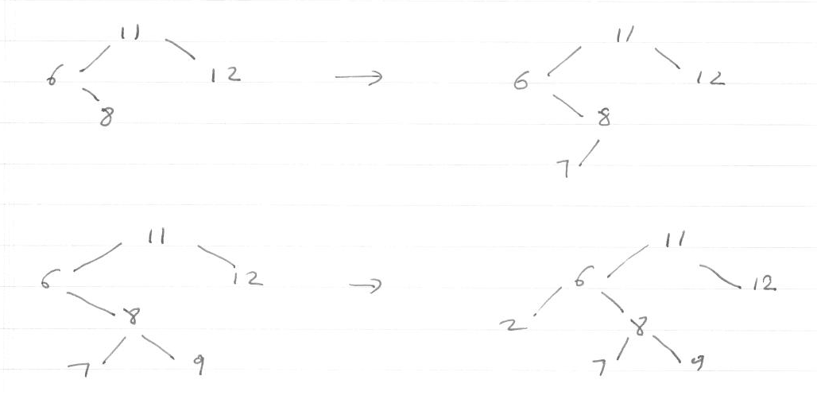
11, 12, 6, 8, 7, 9, 2, 4, 10, 5, 14, 13
added 8
added 7
added 2
added 9
Oct 24, 2011 | CECS 302. Instructor: I Imam

Slide 11
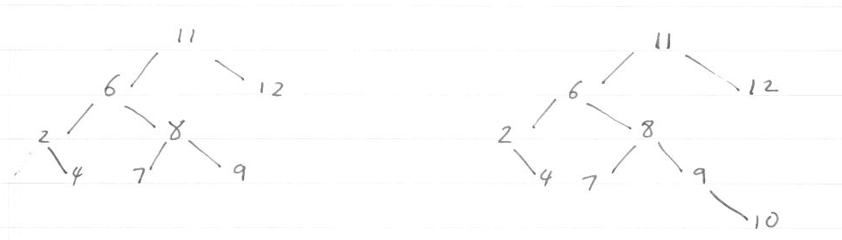
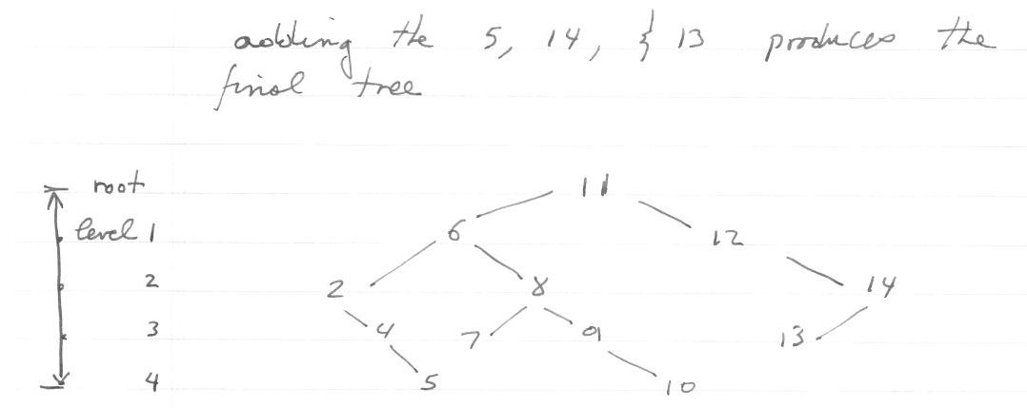
11, 12, 6, 8, 7, 9, 2, 4, 10, 5, 14, 13
Add the 4 and the 10
Oct 24, 2011 | CECS 302. Instructor: I Imam

Slide 12
Oct 24, 2011 | CECS 302. Instructor: I Imam

Slide 13
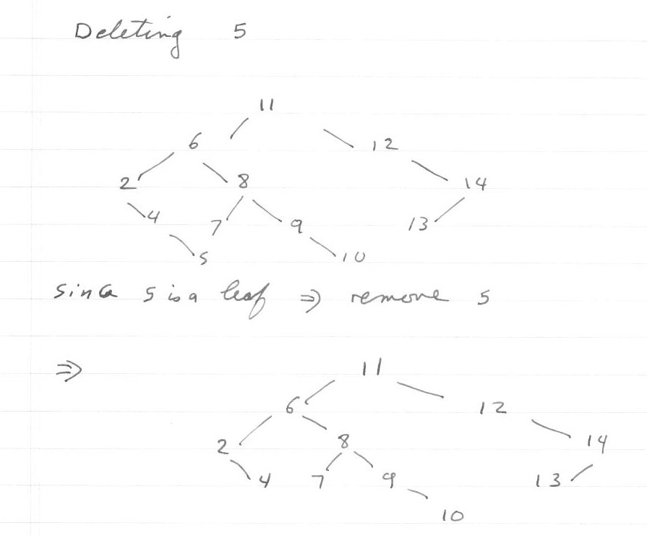
Oct 24, 2011 | CECS 302. Instructor: I Imam

Slide 14
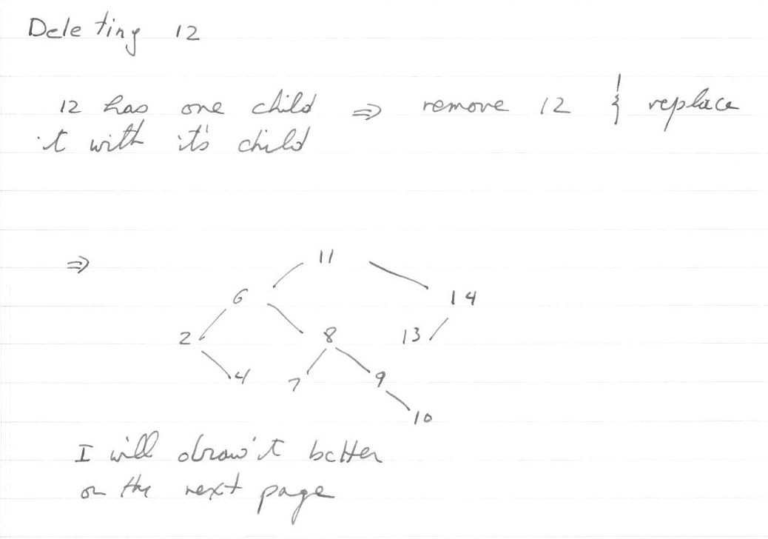
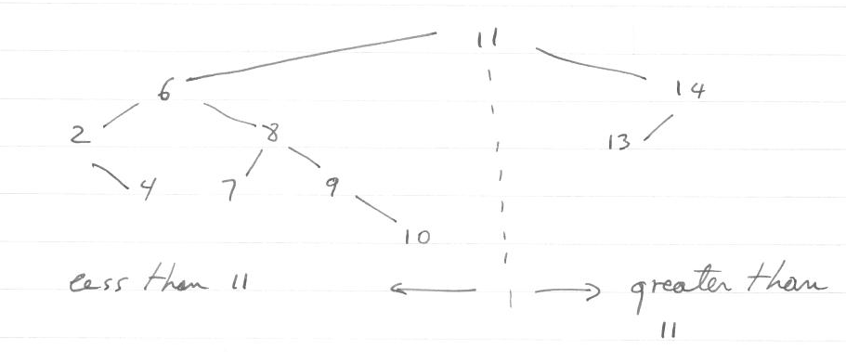
Oct 24, 2011 | CECS 302. Instructor: I Imam

Slide 15
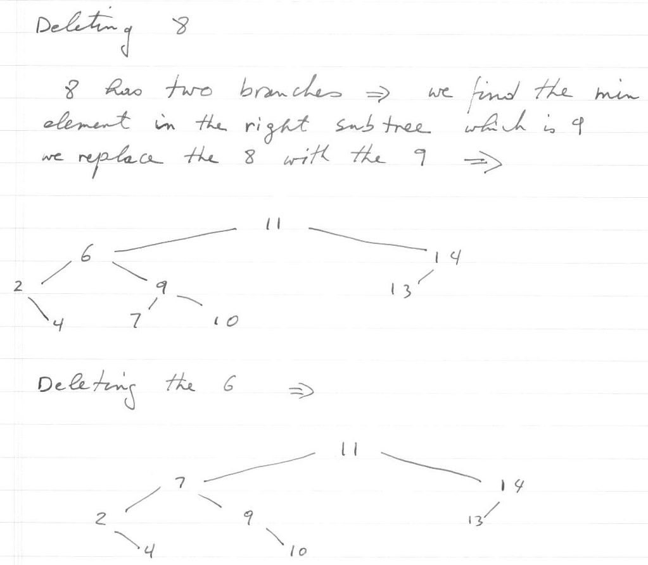
Oct 24, 2011 | CECS 302. Instructor: I Imam

Slide 16
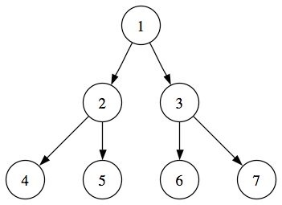
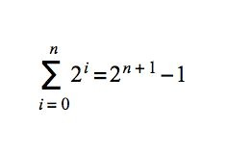
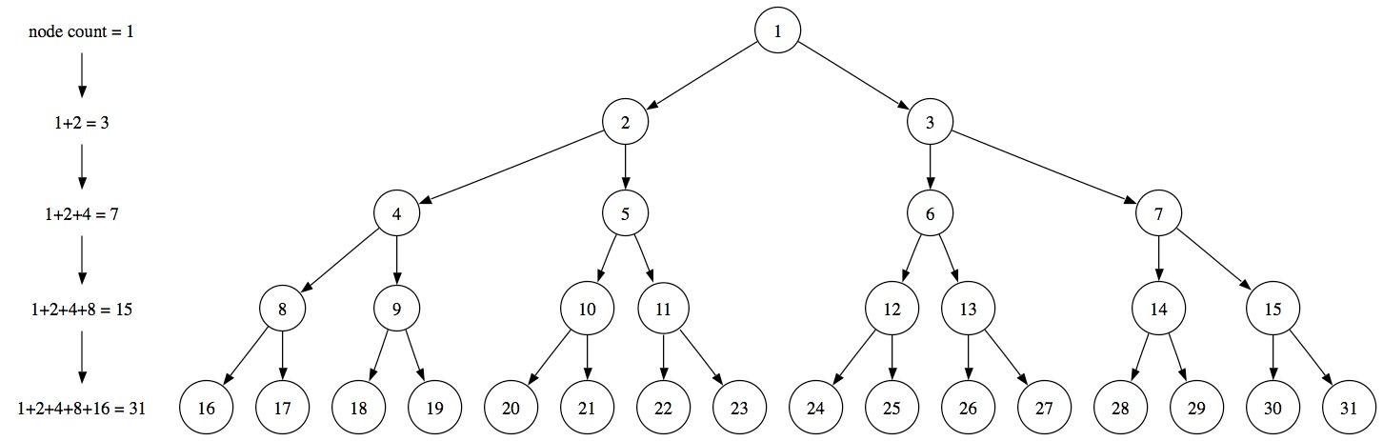
Recall Binary Trees
Recall
In binary trees each node has at most 2 children.
A full binary tree has exactly two children for every internal node.
A full binary tree of height 4 (i.e. it has 5 levels) is shown below.
A full binary tree of height 4 (5 levels) has 2⁰+2¹+2²+2³+2⁴= 31 nodes
For very large trees use the formula to the right where n is the number of levels. (n = 5 for the example below)
Oct 24, 2011 | CECS 302. Instructor: I Imam

Slide 17
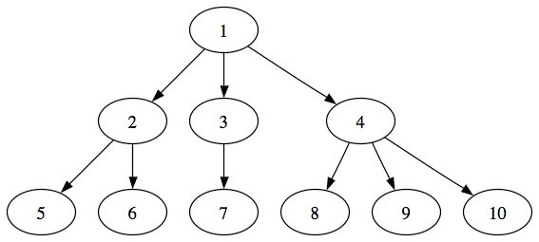
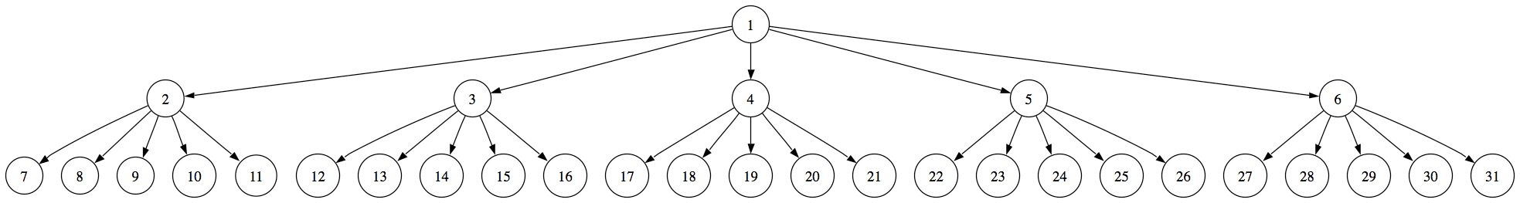
M-ary Trees
Am m-ary tree is a tree where every internal node can have up to m children.
A full m-ary tree is a tree where every internal node has exactly m children.
a 3-ary tree is shown to the right.
Full m-ary trees get shallower and bushier as m increases for the same number of nodes.
Compare the 5-ary tree below having 31 nodes with the binary tree on the previous slide.
The more branching a tree does the shallower it becomes
Oct 24, 2011 | CECS 302. Instructor: I Imam

Slide 18
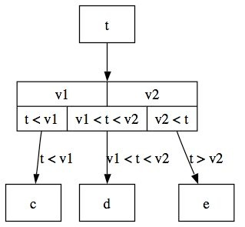
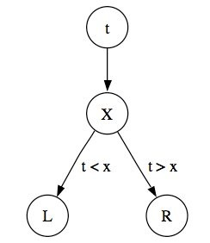
Search trees
Search Trees are used in searching for records pointed to by leaves based on keys stored in nodes.
In binary search trees the process is simple. We move to the left if the value t we are looking for is smaller than the value of the key x and we move to the right if t is larger than x.
In 3-ary search tree we need two keys to give us three ranges
t<v1 to move along path 1 to c,
v1<t<v2 to move along path 2 to d, and
t > v2 to move along path 3 to e.
Oct 24, 2011 | CECS 302. Instructor: I Imam

Slide 19
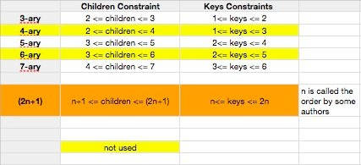
B*-Trees
B*-tree is an m-ary tree that satisfy the following:
All leaves are at the bottom level
All internal nodes except for root have at least ceil(m/2) children
All internal nodes must have at least ceil(m/2) - 1 keys
The root has as few as 2 children or zero for empty trees.
Oct 24, 2011 | CECS 302. Instructor: I Imam

Slide 20
Inserting in B*-tree
To insert an item in a tree we search for the item in the tree.
If the item is in the tree then stop
else the item is not already in the tree and the search leaves you at a leaf.
If there is room in this leaf, just insert the item here (and rearrange the leaf in the correct order)
If this leaf node is full, then the node must be split by taking the middle node up one level and splitting the remaining nodes in half going to the left and one half going to the right. Moving the middle up is another insertion.
Oct 24, 2011 | CECS 302. Instructor: I Imam

Slide 21
Deleting from B*-trees
If the node is in a leaf and the leaf has more than the minimum number of keys then remove node and reorder the leaf.
If the node is in a leaf and the leaf does not have more than the minimum number of keys then remove node will violate the min key requirement. For this case:
If the sibling node to the immediate left or right has an extra key, we can then borrow a key from the parent and move a key up from this sibling.
if neither of the left or right sibling have an extra key then the leaf has to be combined with one of these two siblings. This includes moving down the parent's key that was between those of these two leaves.
If the node is not in a leaf, then it is an internal node. We find its successor (the next item in ascending order), We move the successor up and we delete the successor from its own leaf.
Oct 24, 2011 | CECS 302. Instructor: I Imam

Slide 22
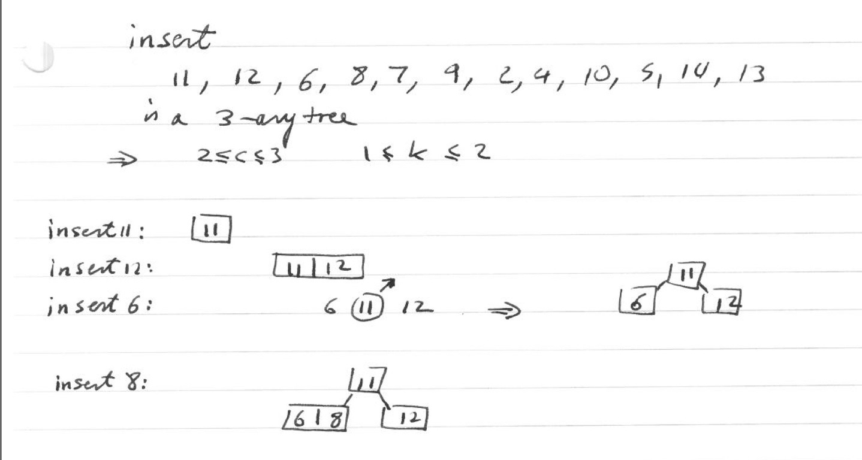
Creating a B* Tree
This example shows the stages of creating a binary search tree of the sequence of numbers:
11, 12, 6, 8, 7, 9, 2, 4, 10, 5, 14, 13
For details see “B*TreeExamples.pdf”
Oct 24, 2011 | CECS 302. Instructor: I Imam

Slide 23
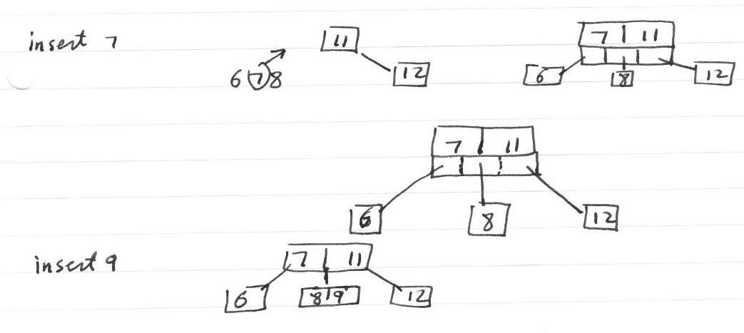
11, 12, 6, 8, 7, 9, 2, 4, 10, 5, 14, 13
Oct 24, 2011 | CECS 302. Instructor: I Imam

Slide 24
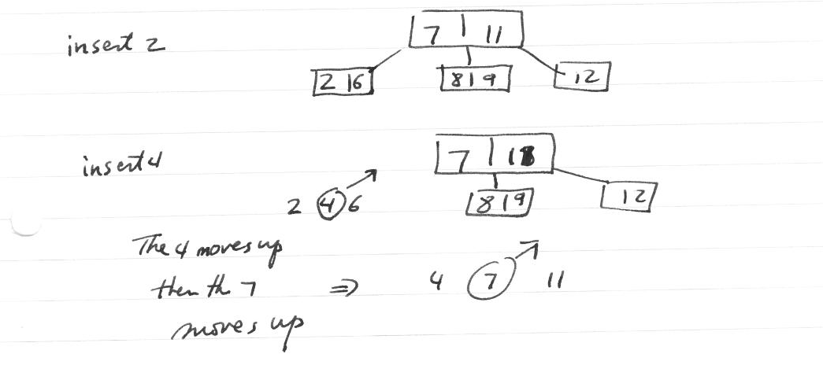
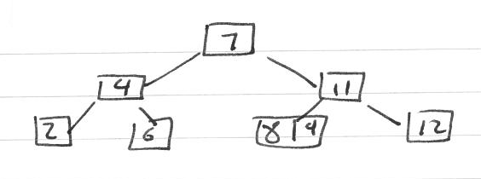
11, 12, 6, 8, 7, 9, 2, 4, 10, 5, 14, 13
Oct 24, 2011 | CECS 302. Instructor: I Imam

Slide 25
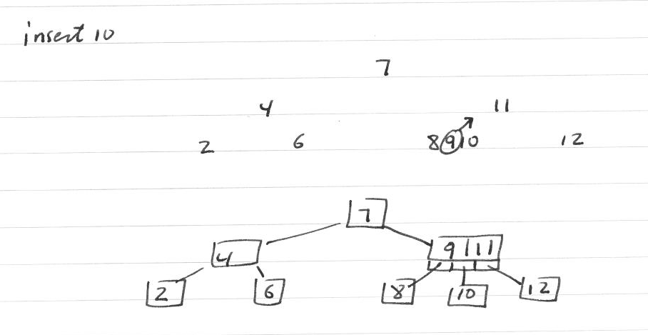
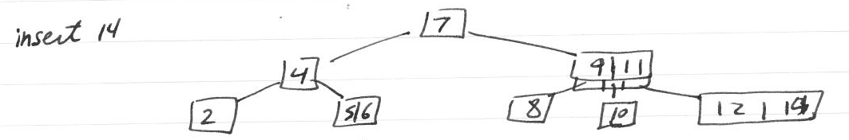
11, 12, 6, 8, 7, 9, 2, 4, 10, 5, 14, 13
Oct 24, 2011 | CECS 302. Instructor: I Imam

Slide 26
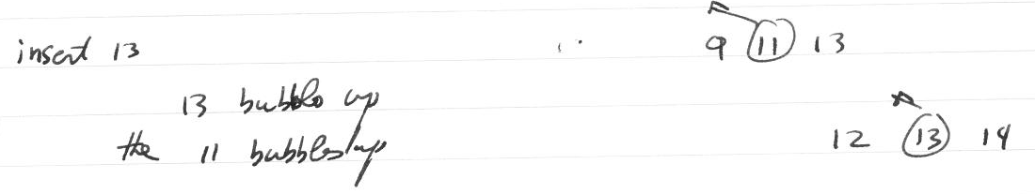
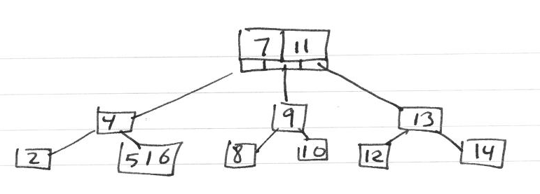
11, 12, 6, 8, 7, 9, 2, 4, 10, 5, 14, 13
Oct 24, 2011 | CECS 302. Instructor: I Imam

Slide 27
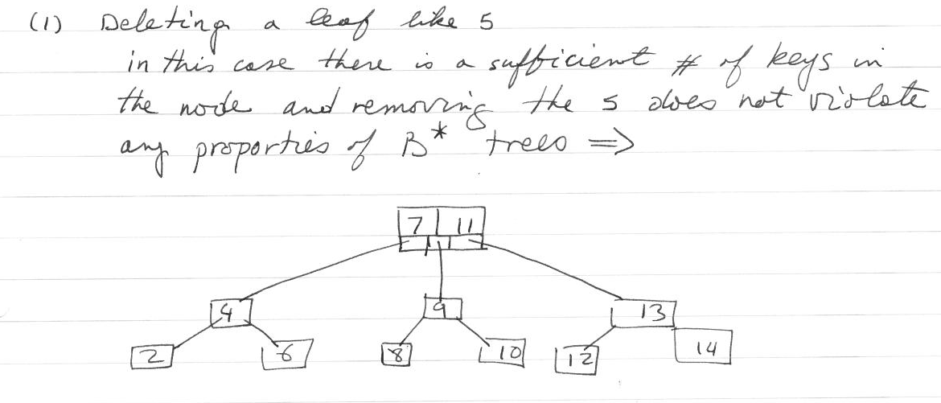
Deleting
Oct 24, 2011 | CECS 302. Instructor: I Imam

Slide 28
Deleting
Oct 24, 2011 | CECS 302. Instructor: I Imam

Slide 29
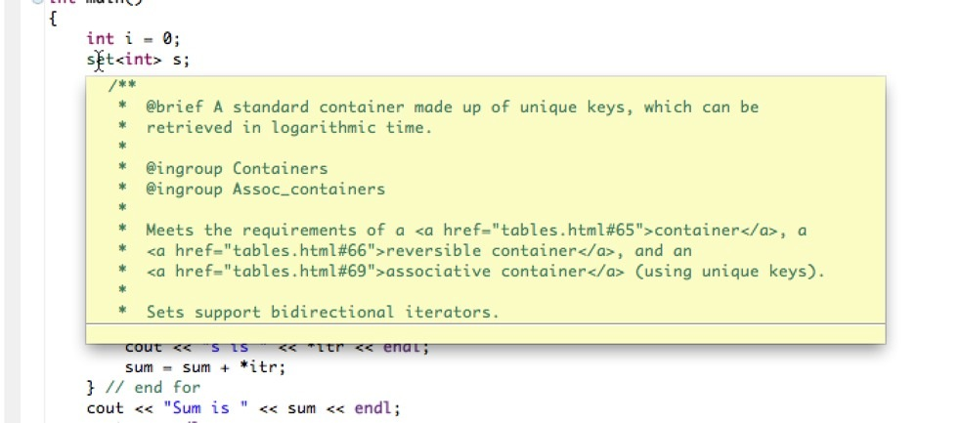
Sets
Oct 24, 2011 | CECS 302. Instructor: I Imam

Slide 30
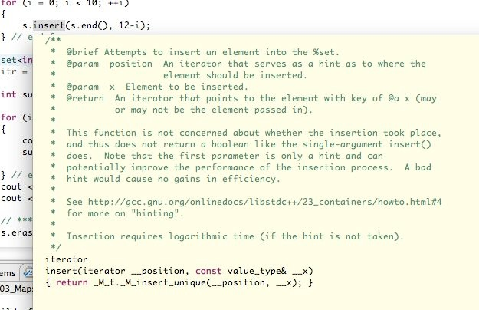
Sets
Oct 24, 2011 | CECS 302. Instructor: I Imam

Slide 31
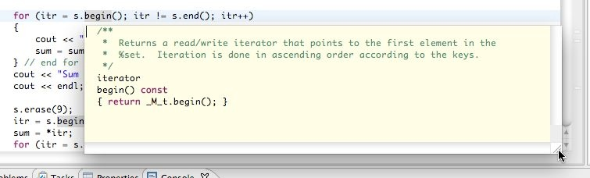
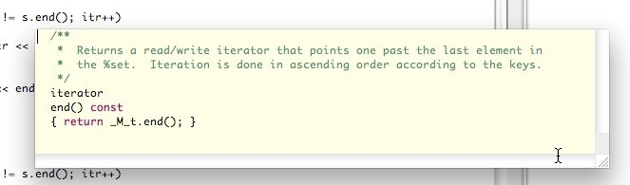
Set begin() and end()
Oct 24, 2011 | CECS 302. Instructor: I Imam

Slide 32
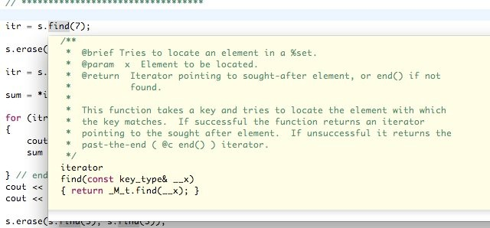
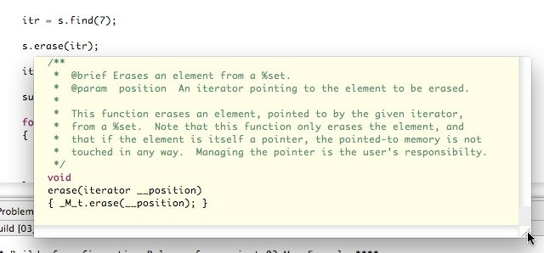
Set find(?) and erase(?)
Oct 24, 2011 | CECS 302. Instructor: I Imam

Slide 33
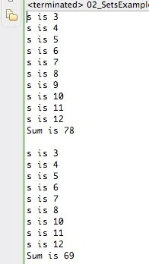
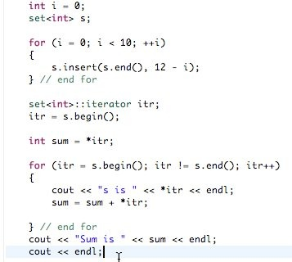
Oct 24, 2011 | CECS 302. Instructor: I Imam

Slide 34
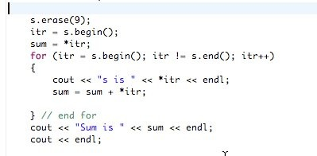
Oct 24, 2011 | CECS 302. Instructor: I Imam

Slide 35
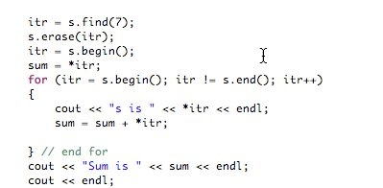
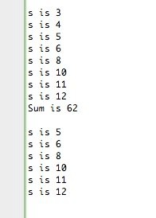
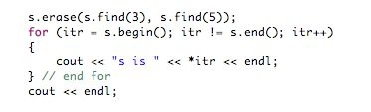
Oct 24, 2011 | CECS 302. Instructor: I Imam

Slide 36
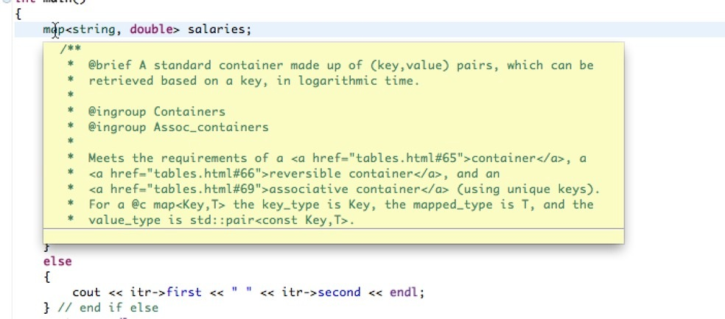
map
Oct 24, 2011 | CECS 302. Instructor: I Imam

Slide 37
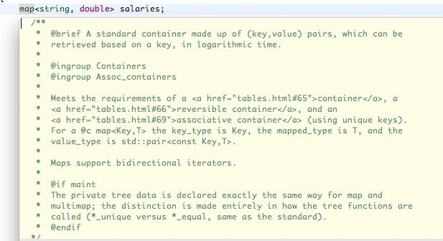
map
Oct 24, 2011 | CECS 302. Instructor: I Imam

Slide 38
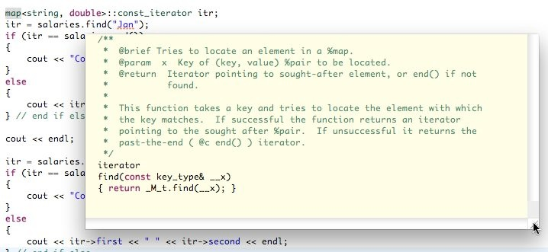
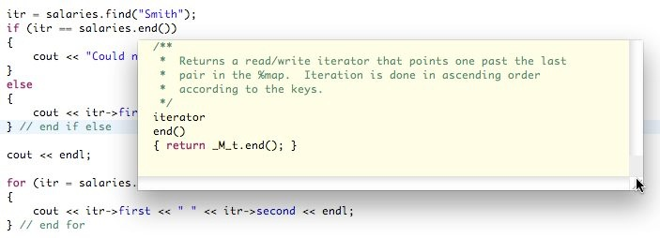
map const_iterator, find(), and end()
Oct 24, 2011 | CECS 302. Instructor: I Imam

Slide 39
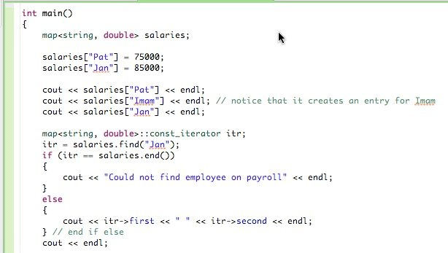
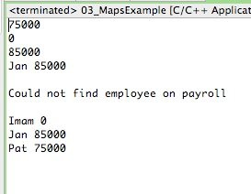
map example
Oct 24, 2011 | CECS 302. Instructor: I Imam

Slide 40

map example (cont.)
Oct 24, 2011 | CECS 302. Instructor: I Imam

